Slide 1

United States of America
Population (2025): 341,784,857

Slide 2

Australia
Population (2025): 27,724,744

Slide 3

Ukraine
Population (2025): 32,862,000

Slide 4

Romania
Population (2025): 19,043,151

Slide 5

Luxembourg
Population (2025): 690,947

Slide 6

Spain
Population (2025): 49,570,725

Slide 7

Canada
Population (2025): 41,575,585

Slide 8

Mexico
Population (2025): 131,946,900

Slide 9

Germany
Population (2025): 83,497,147

Slide 10
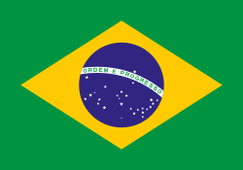
United States of America
Population (2025): 213,421,037

