Slide 1
These are example slides done in MS PowerPoint for you to use as you would like
Click on download and the slides should load on your computer in a MS PowerPoint format
Feel free to contact BMFP with questions
If you are not formular with MS PowerPoint, we are happy to help.

Slide 2

Missions Conference
With BMFP Missionary
Jonathan Lyons
1 – 5 January 2026
Where is Your
Missions Field?

Slide 3

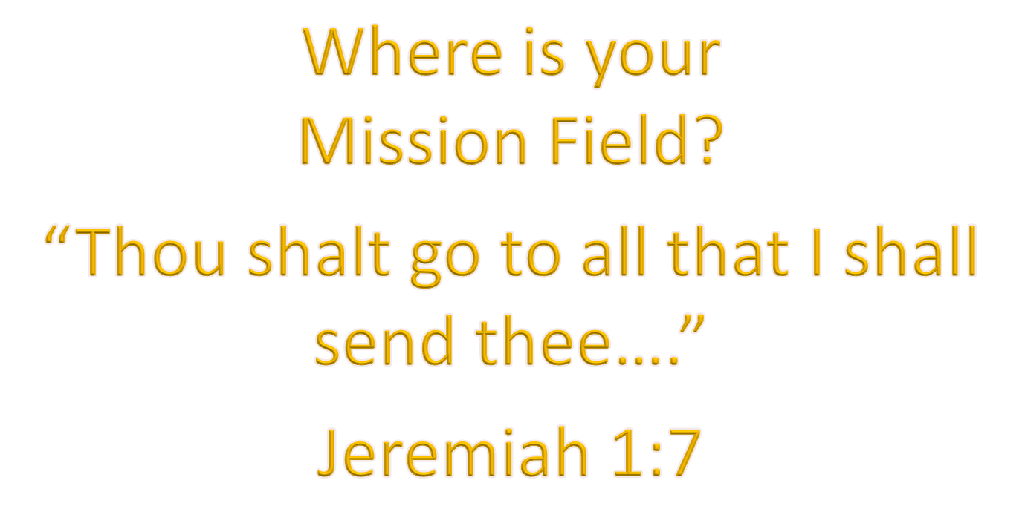
2026 Missions Conference
Sunday – Wednesday
May 1 - 4

Slide 4


Make Your Calendars…
1 – 5 May 2026
Where is Your Mission Field?
“Thou shalt go to all that I will send thee…” Jeremiah 1:7

Slide 5

2026 Missions Conference
1 – 5 May
Missions Meal – May 1st at 4:00 pm
Special Speaker
BMFP Missionary
Jonathan Lyons
Pray for our upcoming
Missions Conference

Slide 6

“Thou shalt go to all that I
shall send thee…”
Jeremiah 1:7
Be Praying & Plan to Attend!
2026 Missions Conference
1 – 5 May
Special Speaker
BMFP Missionary Jonathan Lyons

